Slide 1




3.1 Program Control
Why there is a need for controlling programs?
A computer by itself will not do anything particularly useful
A computer has to be directed to perform some tasks
????
????
????
1
12/01/2021
Notes:
1

Slide 2



3.1 Program Control
In a program, commands are given to the computer through a set of instructions
Program control deals with how a programs gives instructions and takes decisions
Program control directs the program flow or change the program flow using program control statements
1
12/01/2021
Notes:
1

Slide 3
3.2 Program Control Statements
Three types of program control statements
Sequence statements
Selection statements
Repetition statements
1
12/01/2021
Notes:
1

Slide 4
3.3 Sequence Statements
Instructions given in a sequence
Have a begin and an end point
celciusInput = raw_input("Please enter Celcius value:") | S1
celciusFloat = float(celciusInput) | S2
fahrResult = ((9/5.0)*celciusFloat) + 32 | S3
fahrString = format(fahrResult, ".2f") | S4
message = "The result is: " + fahrString | S5
print(message) | S6
Begin
S1
S2
S3
S4
S5
S6
End
1
12/01/2021
Notes:
1

Slide 5
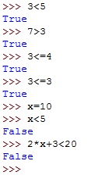
3.4 Selection Statements
Allow the program to choose between two alternatives
Involve a condition
Conditions are Boolean expressions
What is the result of a condition?
Try some conditions in Python:
What values could take a condition?
1
12/01/2021
Notes:
1

Slide 6
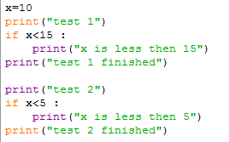
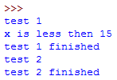
3.4 Selection Statements
The simple if statement
Python syntax
Program control: if the condition is true then the indentedStatementBlock is executed otherwise the indentedStatementBlock is skipped.
Python example
if condition:
indentedStatementBlock
1
12/01/2021
Notes:
1

Slide 7
3.4 Selection Statements
The simple if statement
In class exercise:
Write a Python program that asks for the baggage weight and lets the user know if its weight exceeds the baggage limit of 15 kg.
1
12/01/2021
Notes:
1

Slide 8
3.4 Selection Statements
The if-else statement
Python syntax
Program control: if the condition is true then the indentedStatementBlock ForTrueCondition is executed, otherwise the indentedStatementBlockForFalseCondition is executed.
Python example: verify if a number is odd or even
if condition:
indentedStatementBlockForTrueCondition
else:
indentedStatementBlockForFalseCondition
1
12/01/2021
Notes:
1

Slide 9
3.4 Selection Statements
The if-elif-...-else statement
Python syntax
Program Control: if condition1 is true then the
indentedStatementBlock ForTrueCondition1 is executed,
otherwise if the condition2 is true than the
indentedStatementBlock ForTrueCondition2 is executed...
if condition1:
indentedStatementBlockForTrueCondition1
elif condition2:
indentedStatementBlockForFirstTrueCondition2
elif condition3:
indentedStatementBlockForFirstTrueCondition3
elif condition4:
indentedStatementBlockForFirstTrueCondition4
else:
indentedStatementBlockForEachConditionFalse
1
12/01/2021
Notes:
1

Slide 10

3.5 Repetition Statements
A repetition statement tells the program to execute the program repeatedly
The while statement
Python syntax
Program control: while the loop-continuation-condition is true the indentedBlock is executed
Python example:
while loop-continuation-condition:
indentedBlock
Question: What is printed?
Question: Did you notice the successive modifications?
1
12/01/2021
Notes:
1

Slide 11
3.5 Repetition Statements
The while statement
while statements with successive modifications
initialization
while continuationCondition:
do main action to be repeated
prepare variables for the next time through the loop
1
12/01/2021
Notes:
1

Slide 12
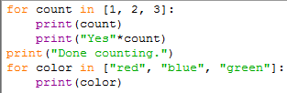
3.5 Repetition Statements
The for statement
Is a counter-controlled loop => you know how many times the loop will execute
Python syntax
Program control: the indented statements to repeat are repeated for each item in the sequence
Python example:
for item in sequence:
indented statements to repeat
1
12/01/2021
Notes:
1

